Slide 1
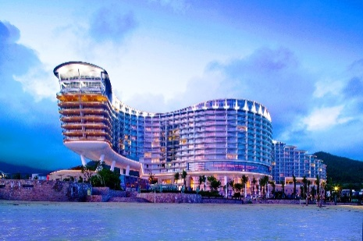
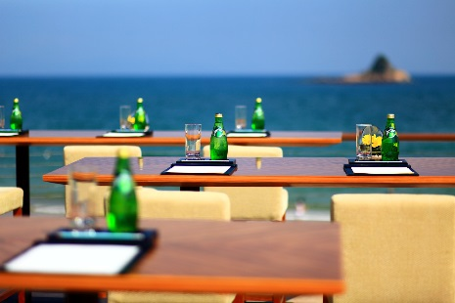
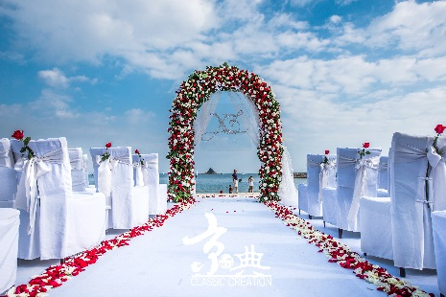
深圳大梅沙京基喜来登度假酒店招聘岗位
酒店简介:大梅沙京基喜来登度假酒店位于位于深圳东部海岸，是一家国际五星级全海景度假酒店。酒店面朝辽阔的大海，背靠美丽的梧桐山，独一无二的地理位置和完善的职业培训体系使每一位在此工作的员工时刻充满活力。
部门： Food & Beverage 餐饮部
职位： Feast Signature Restaurant GSA 盛宴西餐厅服务员
Capri Restaurant GSA 意大利餐厅服务员
Lobby Lounge GSA 大堂吧服务员
Banquet GSA 宴会服务员
部门： Rooms 房务部
职位： Concierge GSA 礼宾员
Guest Service Centre GSA 宾客服务中心接待员
Sheraton Club GSA 行政酒廊接待员
Receptionist 前台接待员
Fitness Centre GSA 健身中心服务员
Room Attendant 客房服务员
福利：公平开放的系统职业发展机会，提供食宿、班车，享有宿舍高速免费Wi-Fi，五险一金，带薪年假，全球姐妹酒店住宿和餐饮优惠、英语津贴。
联系人/电话: Yolanda 0755-22173662 / Derek 0755-22173659
邮箱: yolanda.cao@sheraton.com / derek.dai@sheraton.com
Notes:
FACILITATOR NOTE:
Play video, A Message from Senior Leaders
The video is available through Marriott Global Source
Additional instructions are available within the Facilitator Guide
Distribute copies of the Leader Video Transcript Handout in the required language
KEY POINTS:
As we learned in the last LOCV, our Company’s VISION is to be the number one hospitality company in the world
Mr. Sorenson has been working with our leadership team to ensure we have a well defined strategy in place to help us achieve this goal
To achieve our VISION, Arne and our leaders have developed a clearly defined PURPOSE, outlined our Company VALUES, and created an actionable STRATEGY
TRANSITION:
Let’s look at discuss each of these now…
Speaker: General Manager
Timing: 4 minutes
Resources/Preparation: You will need to download the video in advance of the session and play as a separate file.

