Slide 1
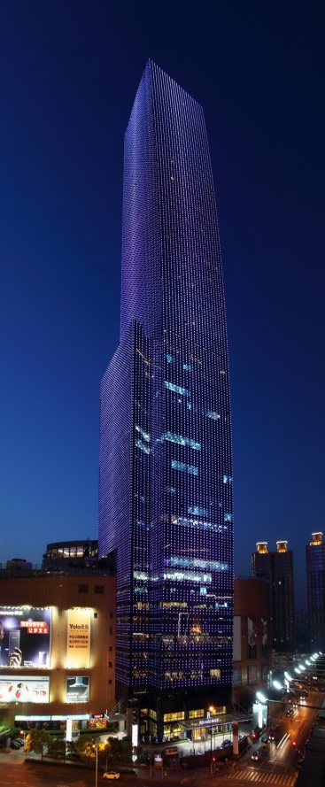
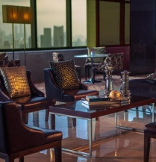
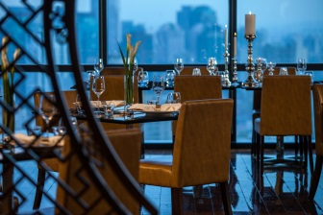
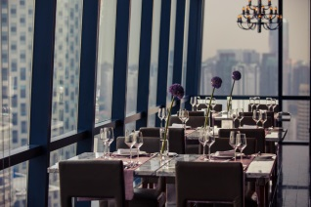
上海龙之梦万丽酒店招聘岗位
酒店简介:上海龙之梦万丽酒店,一个奢华、生活化的万豪酒店。值得骄傲是，这是世界上最高的万丽酒店, 一幢综合商务楼和大型购物中心的建筑,向顾客提供了便捷的娱乐消遣的渠道。酒店位于上海市中心的一个独特的位置，坐落在2、3和4线中山公园地铁站，前往虹桥机场只需18分钟；同线50分钟即可到达浦东国际机场，共有667间豪华客房和套房。
部门： Rooms 客务部
职位： Executive Floor Agent 行政楼层接待 （2人）
Delight to Serve Agent 乐意服务中心文员（2人）
Bellboy 行李员（2人）
Health Club Agent 健身中心接待 （2人）
Housekeeping Order Taker 客房文员（2人）
部门： F&B 餐饮部
职位： Waiter 餐厅服务员 ( 5人）
联系人/电话: Yvonne Liu/15021335419
邮箱: rhi.shabz.recruitment.mgr@renaissancehotels.com
Notes:
FACILITATOR NOTE:
Play video, A Message from Senior Leaders
The video is available through Marriott Global Source
Additional instructions are available within the Facilitator Guide
Distribute copies of the Leader Video Transcript Handout in the required language
KEY POINTS:
As we learned in the last LOCV, our Company’s VISION is to be the number one hospitality company in the world
Mr. Sorenson has been working with our leadership team to ensure we have a well defined strategy in place to help us achieve this goal
To achieve our VISION, Arne and our leaders have developed a clearly defined PURPOSE, outlined our Company VALUES, and created an actionable STRATEGY
TRANSITION:
Let’s look at discuss each of these now…
Speaker: General Manager
Timing: 4 minutes
Resources/Preparation: You will need to download the video in advance of the session and play as a separate file.

